Slide 1
Cloudburst Modeling Update
QMSS GR5055 Data Analysis Practicum
April 17, 2025

Slide 2
Introduction

Slide 3




Our Team
Jackie Cheng
Kevin Chien
Ariel Shao
Linda Xi
Sociology
Accounting
Economics & Psychology
Economics & Psychology

Slide 4



Our Team
Davena Xiao
Hanyi Xu
Kendrick Yu
Economics,
specializing in health & development economics
Communications &
Human–computer interaction
Psychology & Experience Design

Slide 5


Objectives & Scope
Detect cloudburst within a 3-hour window
Achieve prediction accuracy above current 50% baseline in target areas
Enhance early warning systems for disaster preparedness
Machine learning model supported by performance analysis
Documentation of methodology and algorithms
Data visualizations and recommendations for real-world use

Slide 6
Key Challenges in Cloudburst Prediction
Rare Event Modeling:
Cloudbursts are extremely rare
→ class imbalance
Data Sparsity:
Limited weather station coverage
Generalizability:
U.S.-trained models may not transfer well
Meteorology:
Accurate prediction may require explicit modeling of weather dynamics

Slide 7
Literature Review

Slide 8
Key Papers in Cloudburst Prediction
Murakami et al. (2022)
Used a deep learning autoencoder to detect precipitation anomalies in Japan.
Found rising extreme events linked to climate change.
No precision/recall—unsupervised anomaly detection via MSE thresholds
Patil & Kulkarni (2023)
Combined GFS forecasts + ML (XGBoost, NeuralNet).
Binary: Accuracy 88%, F1 = 0.84, Precision = 0.85, Recall = 0.83
Multiclass: F1 = 0.83, Precision = 0.84, Recall = 0.82
Shani & Nagappan (2024)
Used GAF + CNN to classify cloudburst events.
Burst class (value = 1): Accuracy = 86.4%, F1 = 0.66, Precision = 0.78, Recall = 0.58

Slide 9
Comparative Summary of Methods, Data, and Performance Metrics
 | Murakami et al. (2022) | Patil & Kulkarni (2023) | Shani & Nagappan (2024)
Region Studied | Japan | India | India (unspecified region)
Data Type | APHRODITE daily precipitation, JRA-55 reanalysis, IBTrACS cyclones, HiFLOR/SPEAR model outputs | GHCN daily rainfall (37 train, 18 test stations); GFS forecasts (50 atmospheric features, 6-hourly up to 7 days) | Weather condition vectors (temperature, humidity, UV, etc.); converted to images via GAF
Time Frame | 1977–2015 (obs); simulations through 2050 | June–September 2015 | Real-time conditions; no historical window specified
Best Model | HiFLOR + autoencoder (MSE) | XGBoost w/ GFS | CNN (GAF images)
Binary F1 | N/A (unsupervised) | 0.84 | 0.66 (burst)
Precision (burst) | N/A | 0.85 | 0.78
Recall (burst) | N/A | 0.83 | 0.58

Slide 10
Bridging to Our INDRA Project
Literature helps us define scope:
Murakami et al.: Useful for understanding large-scale anomaly detection and climate trends. Helps define baseline variability but not usable for short-term predictions.
Patil & Kulkarni: Shows how combining GFS + supervised ML improves short-term forecasts. Their high F1, precision, recall makes this highly relevant to our 6-hour prediction goal.
Shani & Nagappan: Offers an event-level CNN classifier. Moderate recall (0.58) suggests it misses some events, but could serve as a starting architecture baseline.

Slide 11
Existing GitHub Models

Slide 12
Existing GitHub Models Examples
https://github.com/prathameshpahune/Cloudburst-Prediction-System.git
https://github.com/Pramit726/Predict-Cloudburst.git
https://github.com/Ayush-Priyam/Rain-Prediction.git
https://github.com/swarnava-96/Rainfall-Prediction.git (good visualization and large amount of ML models)
https://github.com/parinithshekar/rainfall-prediction.git

Slide 13
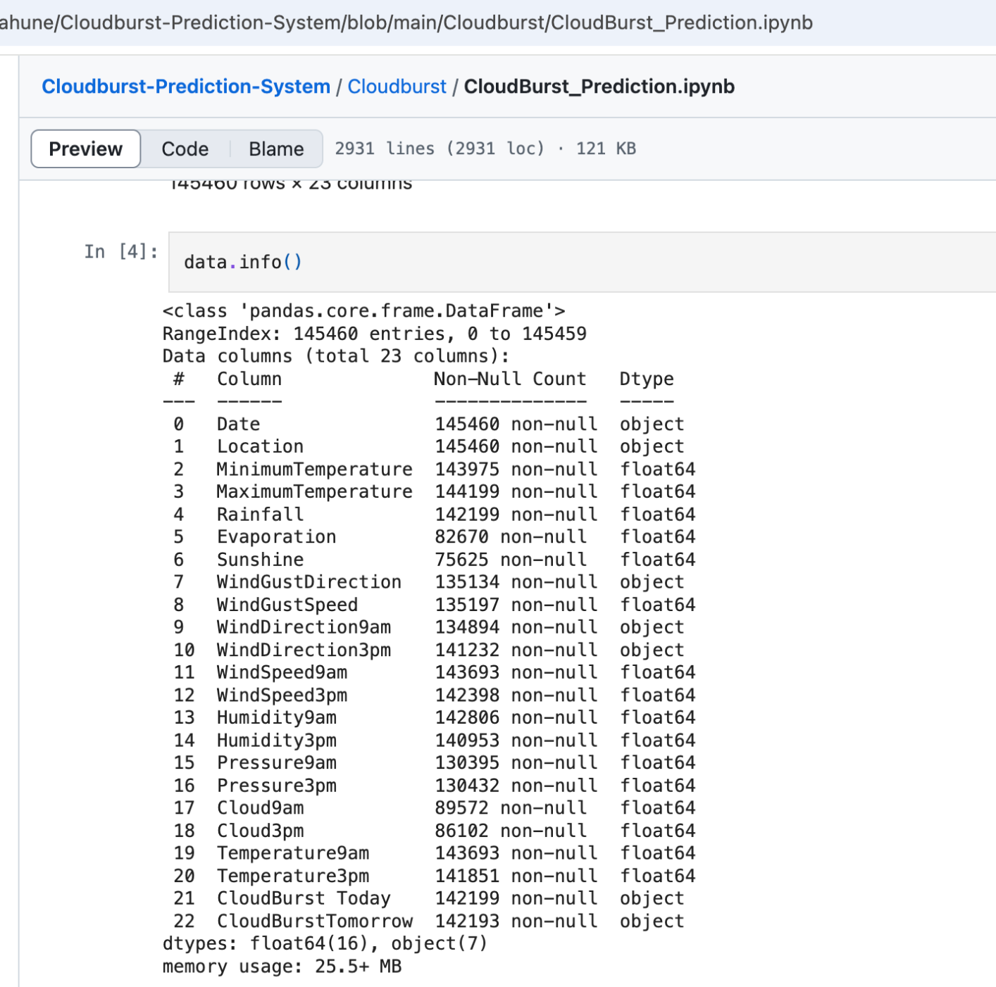
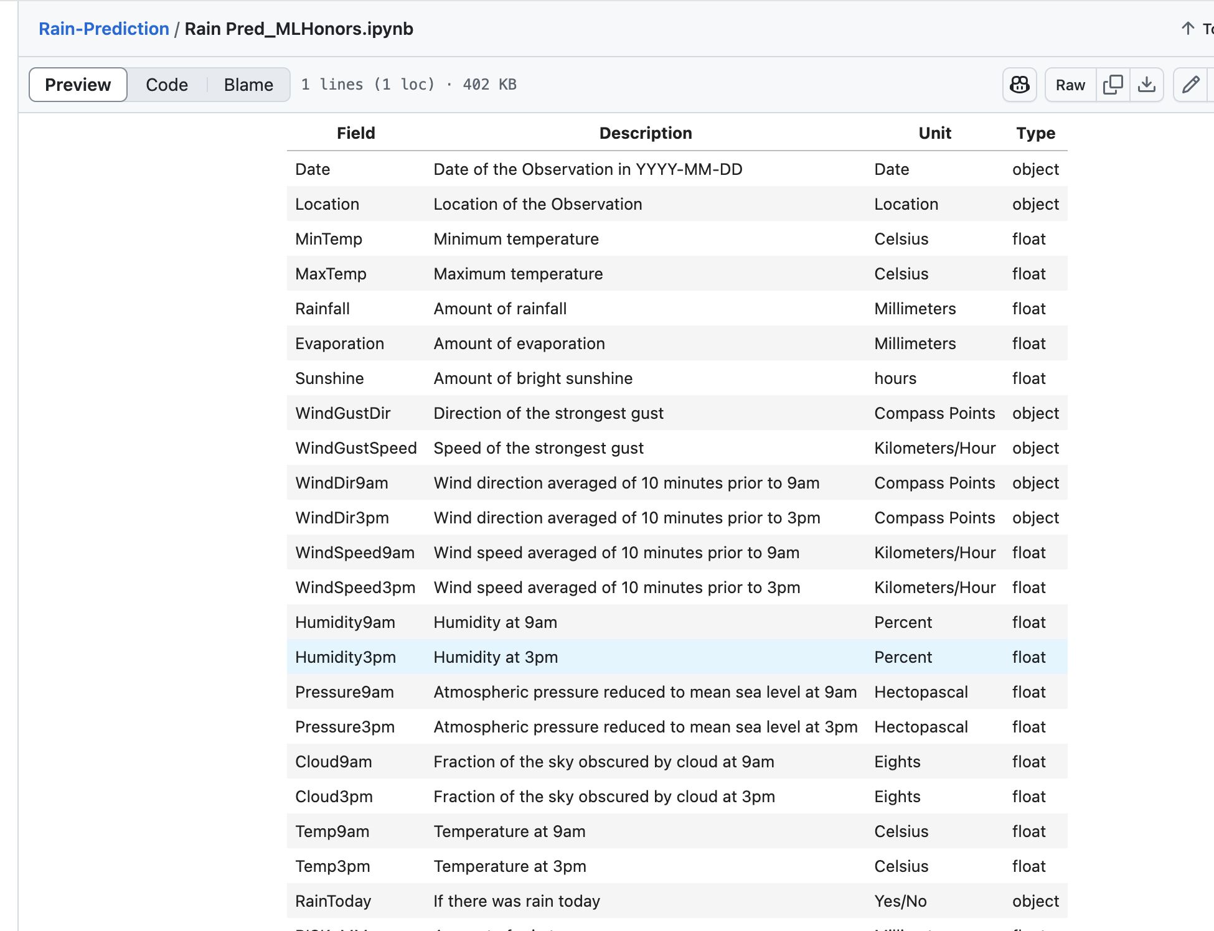

Slide 14
Comparisons & Strengths
Many used the same data source, with similar key predictors (1, 3, 4 utilized Australia 2008-2017 weather data)
Similar objective: predicting cloudburst tomorrow
Similar data pre-processing methods
Used slightly different machine learning models (e.g. Linear Regression, Logistic Regression, Random Forests, XGBoost, SVC)

Slide 15
Limitations
Temporal Resolution
No real-time adaptation
Example 5 does not have enough codes for evaluation/access goodness of fit
Have not found relevant examples using datasets from NOAA

Slide 16
Data Sources

Slide 17
Overview of Potential Data Sources Reviewed
Over 20 datasets examined from global and regional sources
Focused on datasets offering precipitation/rainfall data, ideally hourly or sub-hourly
Evaluated based on:
Temporal resolution (hourly preferred)
Spatial resolution (km or grid size)
Coverage (relevance to SE Asia)
Accessibility (ease of download, format)
Types of data: Satellite-based estimates, weather station reports, forecast models

Slide 18
Data Summary and Selection
Several datasets, though promising, required extensive preprocessing or data merging efforts not feasible within project scope
Regional datasets for India lacked the required hourly temporal resolution, offering only daily or monthly data
Many high-quality sources were limited to CONUS (Continental U.S.)
NOAA satellite-based products provided optimal coverage across tropical and Southeast Asian regions
Chose NOAA LCD data, which aligns with project goals by balancing temporal granularity, spatial relevance, and data accessibility

Slide 19
Challenges in Transferring US-Based Models to SE Asia
Climate Pattern Differences
Monsoon dynamics
Tropical cyclone characteristics
Orographic effects
Fundamental Data Differences
Geographic coverage gap
Station density disparities
Measurement standardization
Technical ML Transfer Issues
Feature distribution shifts
Temporal resolution mismatch
Missing contextual variables
Feedback loop limitations

Slide 20
NOAA Local Climatological Data (LCD) Overview
Source: National Oceanic and Atmospheric Administration (NOAA)
Scope: Hourly and daily meteorological observations, 100000 in total
Station ID: 72202012839（MIAMI INTERNATIONAL AIRPORT)
Time Span: Starting from January 1, 2015 to December 31,2024
Data Type:
Hourly: temperature, dew point, wind speed/direction, pressure, humidity, visibility, sky condition, precipitation
Daily: max/min/average temperature, snow depth, peak wind, total precipitation
Monthly: climate norms, deviations, extreme values
Features:
120+ columns
Includes derived variables like heating/cooling degree days, short-duration precipitation
Time-stamped in ISO format (e.g., 2015-01-01T00:53:00)
Notes:
The NOAA Local Climatological Data (LCD) dataset is an hourly weather observation dataset provided by the National Oceanic and Atmospheric Administration (NOAA), collected from automated weather stations across the U.S., such as those located at airports.

Slide 21
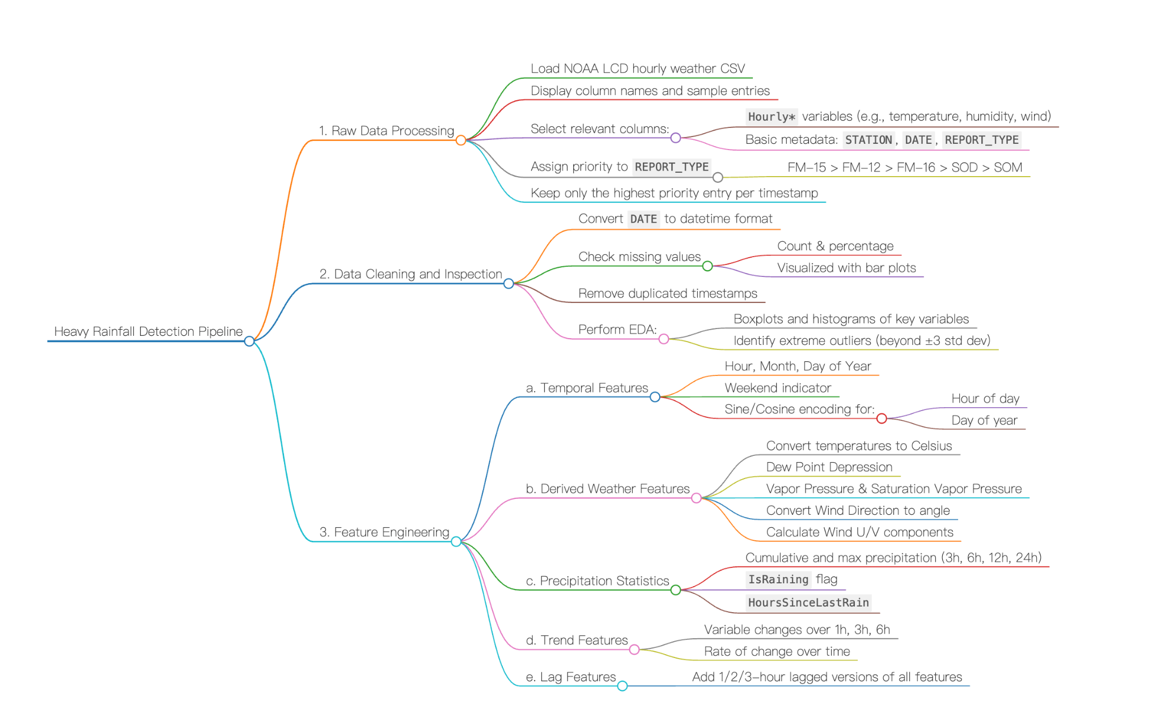
Data Cleaning & Feature Engineering
Data Processing Steps
Load raw NOAA hourly weather data Select relevant columns (Hourly variables + metadata)
Filter by report priority (FM-15 > FM-12 > FM-16 > SOD > SOM)
Convert timestamps to datetime format
Check and visualize missing values
Remove duplicates and outliers
Feature Engineering
Time features: hour, month, weekend, sin/cos
Weather-derived features: vapor pressure, wind U/V
Precipitation stats: cumulative, max, rain flags
Trends & lags: 1h/3h/6h change and delays
Preparation for Modeling
Scaling
Time-based train/val/test split
Class balancing
Notes:
Type
Purpose
Converting DATE to datetime format allows for easier time-based operations like filtering, sorting, resampling, extracting features (e.g., hour, month), and calculating time differences. FM-15 (METAR)
Routine hourly weather observations
FM-16 (SPECI)
Non-routine METAR reports triggered by special weather conditions
FM-12 (SYNOP)
Scheduled reports used for international data exchange, typically at wider time intervals

Slide 22
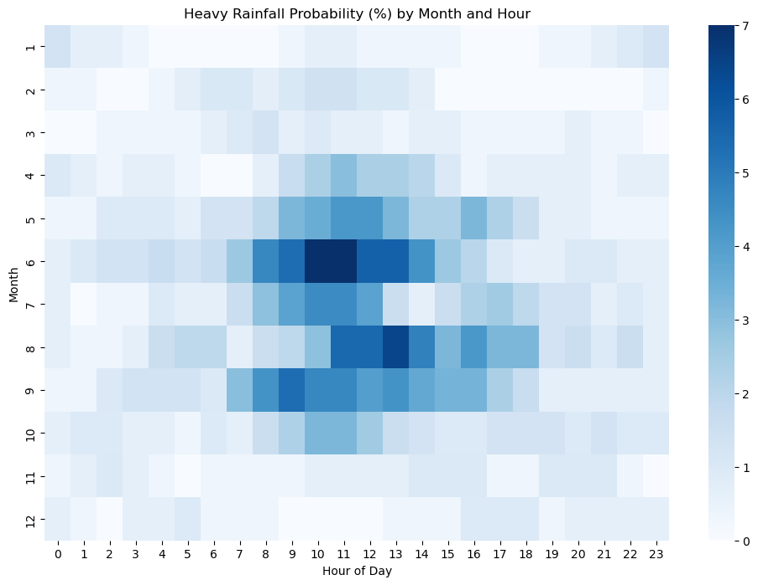
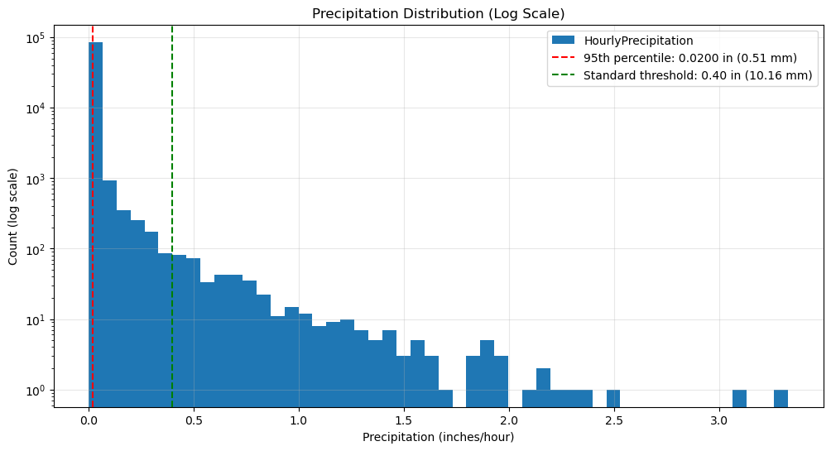
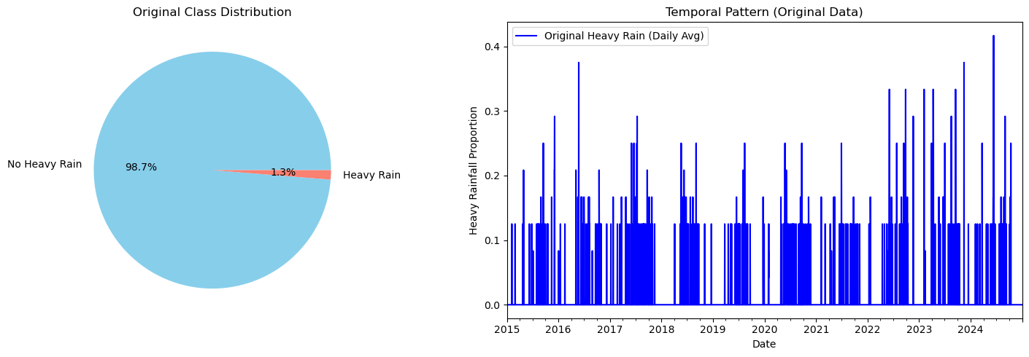
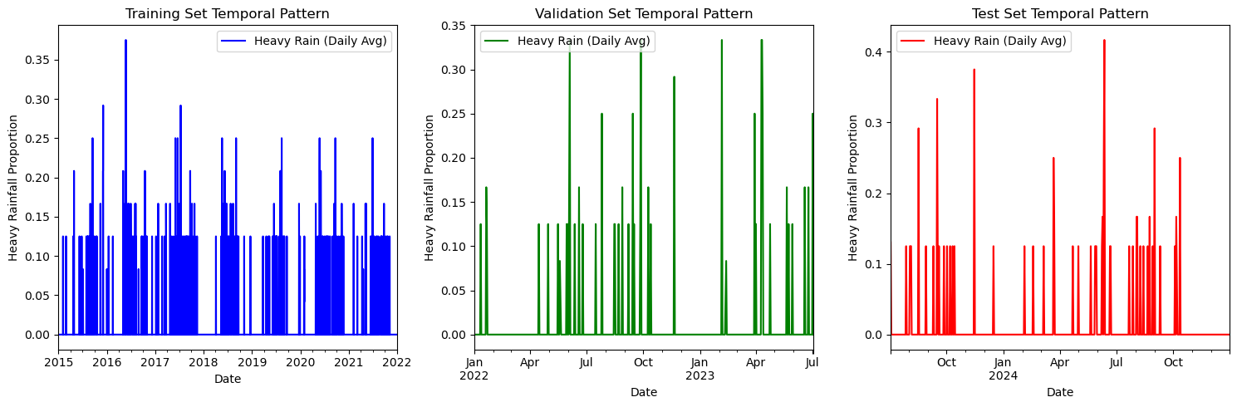
Cleaned Data Overview

Slide 23
Machine Learning Approaches

Slide 24
Time stamp we will measure
Label
Cloudburst y/n?
🌤️🌦️🌧️🌩️❄️
Time Series Data
3 hours

Slide 25

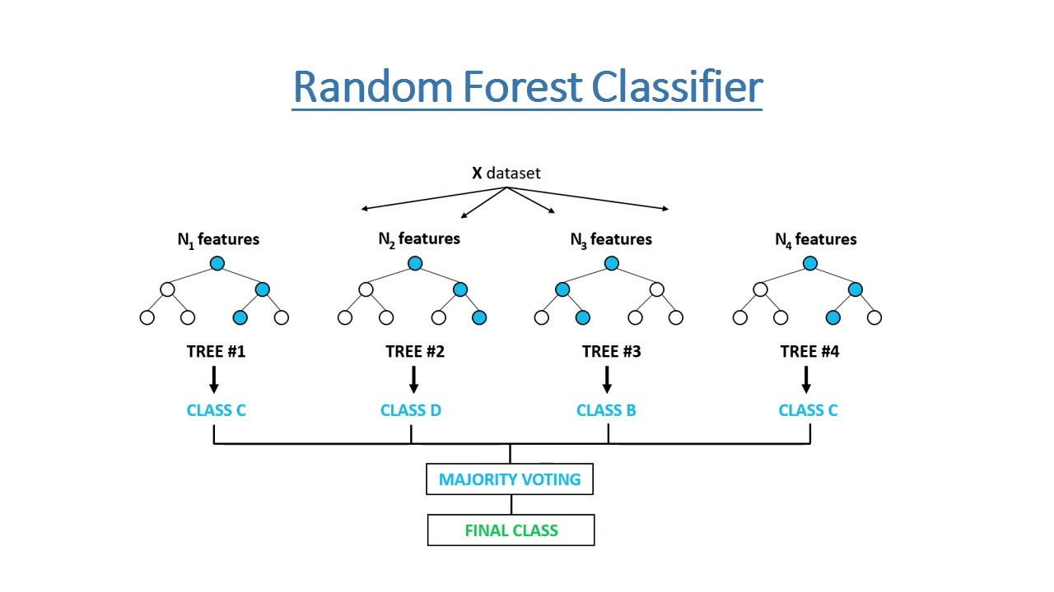

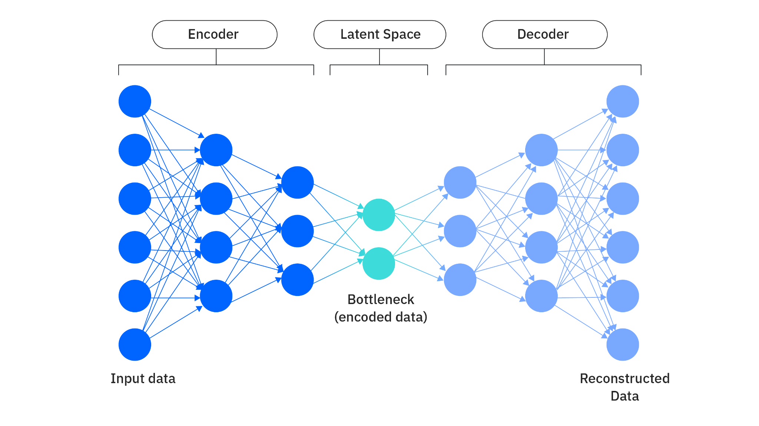


Model Choices
Random Forest
Handles complex, nonlinear patterns
Robust to noisy and missing data
Works well with many features
Feature importance analysis
Autoencoder
Good at detecting anomalies
Can process high-dimensional data
Learns unsupervised

Slide 26
Our Model
Parameter / Metric | Value | Explanation
n_estimators | 200 | Number of trees in the forest
max_depth | 10 | Maximum depth of each tree
min_samples_split | 10 | Minimum samples required to split an internal node
min_samples_leaf | 4 | Minimum samples required at a leaf node
class_weight | 'balanced' | Adjusts for class imbalance
Precision (class 1) | 0.0825 | Low: ~7.3% of predicted ‘positives’ were correct — high false positive rate
Recall (class 1) | 0.6075 | High: Model captured ~57.8% of actual positive cases (heavy rainfall events)
F1 Score | 0.2088 | Balances precision and recall: better than Autoencoder but still modest
ROC AUC | 0.8551 | Strong: Good overall ability to rank predictions under class imbalance

Slide 27
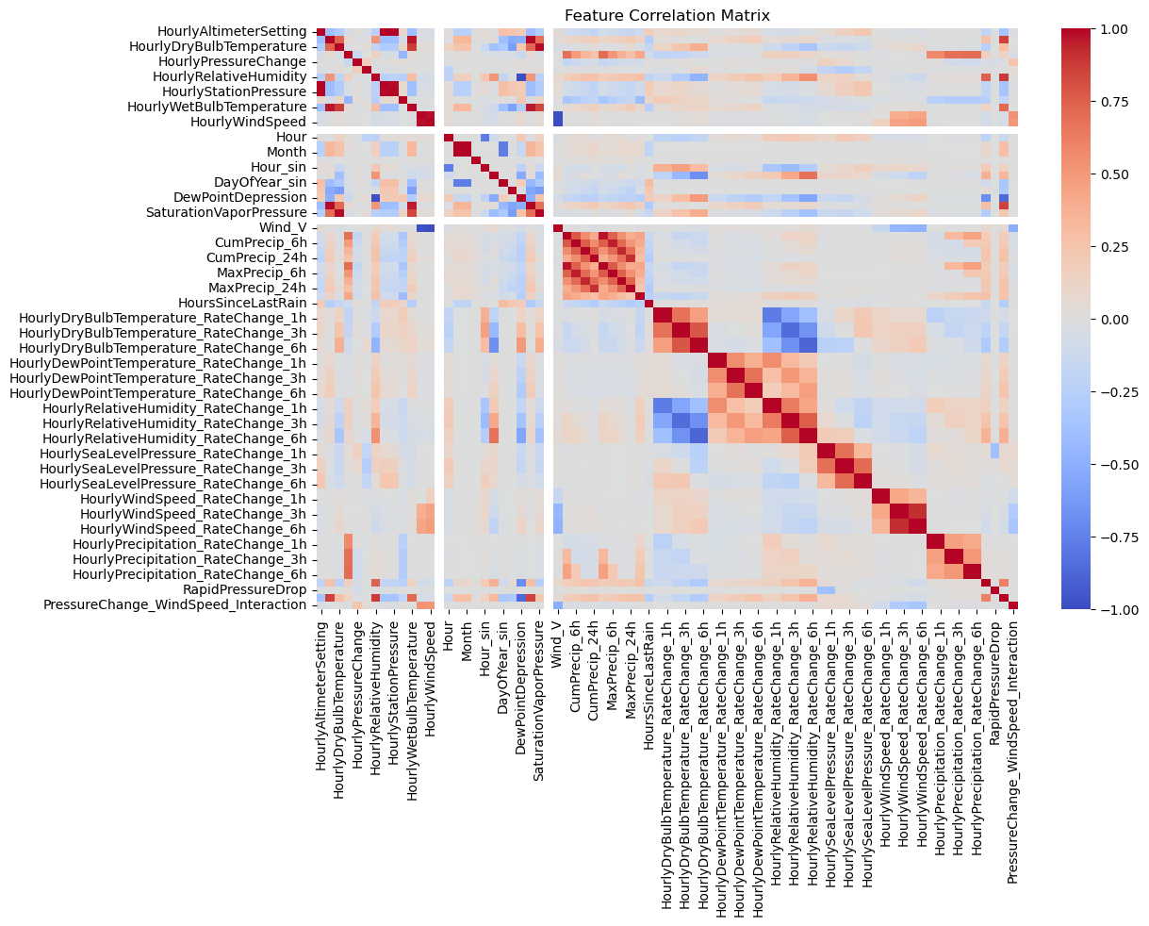
🌡️ Temperature features (DryBulb, WetBulb, DewPoint) are strongly correlated.
🌧️ Precipitation features (CumPrecip, MaxPrecip) are highly correlated across time ranges.
⏰ Time features (Hour, Month, DayOfYear) have low correlation with weather variables — they add unique signals.
📉 Pressure change is negatively correlated with humidity and wind speed changes — indicates storm conditions.
🔁 Rate change features (e.g., wind, humidity) across 1h/3h/6h are highly correlated — may reduce to fewer features.

Slide 28
Model Reinforcement and Challenge
Our next steps:
Address Class Imbalance
Handle imbalance with SMOTE/undersampling (sklearn imbalanced-learn)
Improve Feature Engineering
Engineer or reintroduce useful features
Use Stratified CV
Try to use neural network deep learning
Evaluate with PR AUC or confusion matrix
Data Quality & Enrichment
Remove time stamp in feature importance
Remove missing data

Slide 29
Conclusions

Slide 30
Summary of Project Activities
📚 Reviewed existing research & GitHub models
🔎 Assessed 20+ datasets --> NOAA LCD
🧹 Cleaned data and engineered meteorology-specific features
💻 Built predictive models using Random Forest and Autoencoder
🎯 Achieved precision of 0.0825 and recall of 0.6075

Slide 31



Preliminary Recommendations
Enhance model performance
incorporating additional, higher-resolution datasets
Consult climate science experts
advanced feature engineering
Develop a user-friendly interface

Slide 32
Next Steps & Timeline
Start finalizing the report
April 24th
April 17th
May 1st
Incorporate today’s feedback
Fine-tune the model
✔️
submit all deliverables
Last push
👊🏼

